Slide 1
Advanced Data Analytics: View Manipulation
Ian Nabney
ian.nabney@bristol.ac.uk

Slide 2
Overview
Reading: Chapter 11 of Munzner
Understand the design choices to manipulate a view: to change it, select items or attributes, navigate to a different viewpoint
Able to apply appropriate choices to design challenges

Slide 3
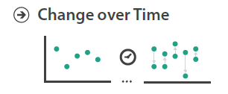
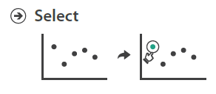
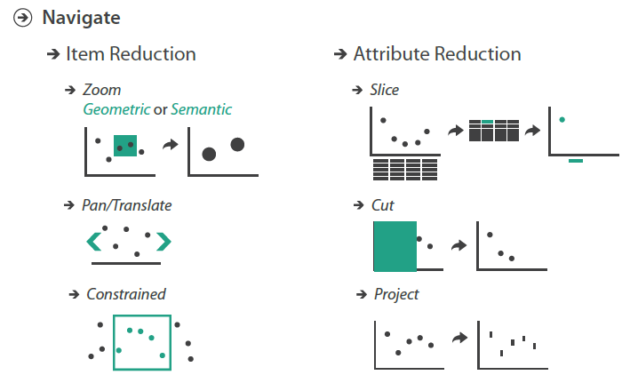
Big Picture

Slide 4
Why change the view?
Datasets are often sufficiently large and complex that showing everything at once in a single static view would lead to overwhelming visual clutter.
There are five major options for handling complexity
a view that changes over time;
deriving new data (see Task Abstraction lecture – week 2);
faceting data by partitioning it into multiple views or layers (second lecture this week);
reducing the amount of data shown (week 6);
embedding focus and context in a single view (week 6).
These five choices are not mutually exclusive and can be combined together.
Changing the view over time is the most obvious, most popular, and most flexible choice in vis design.
The most fundamental breakthrough of vis on a computer display compared with printed on paper is the possibility of interactivity: a view that changes over time can dynamically respond to user input, rather than being limited to a static visual encoding.

Slide 5
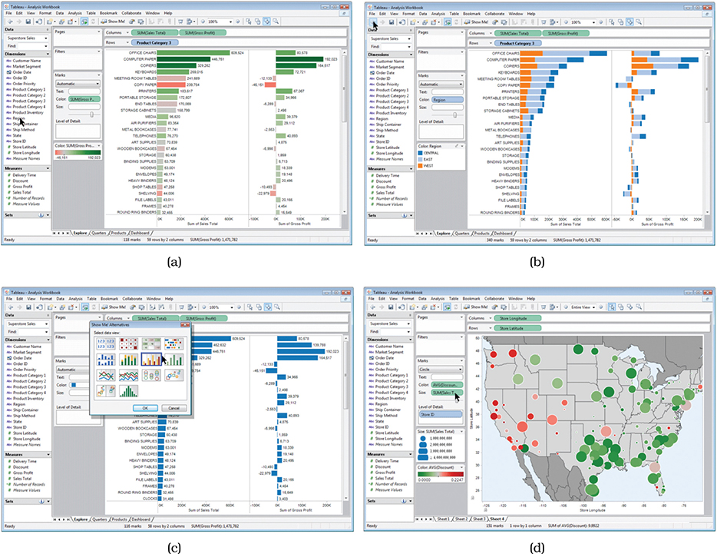
Changing view over time
The possibilities for how the view changes can be based on any of the other design choices of how to construct an idiom: change the encoding, change the arrangement, change the order, change the viewpoint, change which attributes are filtered, change the aggregation level, etc.
Bar chart
Stacked bars
Show Me recommendations
Spatial geometry as a substrate, with circular area marks size coded for the sum of sales and colour coded with a diverging red–green colormap showing the average discount.

Slide 6
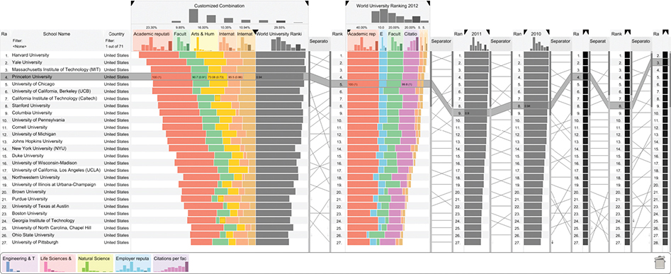
Example: LineUp
The power of reordering lies in the privileged status of spatial position as the highest ranked visual channel. Reordering data spatially allows us to invoke the patternfinding parts of our visual system to quickly check whether the new configuration conveys new information.
It can be used with any categorical attribute. In contrast, reordering does not make sense for ordered attributes, which have a given order already.

Slide 7
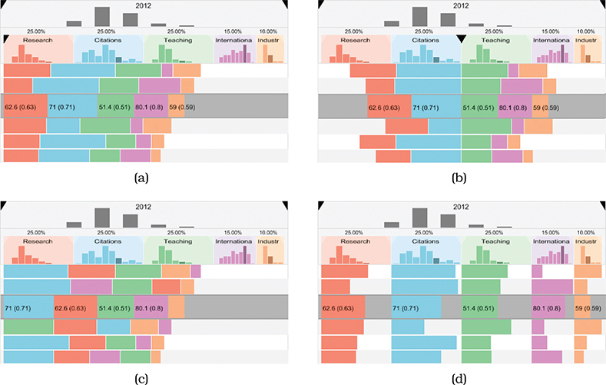
LineUp: changing alignment
Changing the alignment in Lineup. (a) Classical stacked bars. (b) Diverging stacked bars based on selected attribute. (c) Ordered stacked bars. (d) Separately aligned bars: small multiple bar charts. When the alignment is changed, an animated transition between the two states occurs.

Slide 8
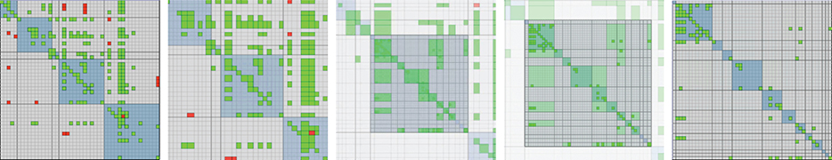
Example: animated transitions
The benefit of animated transitions is that they help users maintain a sense of context between the two states by explicitly showing how an item in the first state moves to its new position in the second state, rather than forcing users to do item tracking on their own using internal cognitive and memory resources.
These transitions are most useful when the amount of change is limited, because people cannot track everything that occurs if many items change in different ways all over the frame.
They work well when either a small number of objects change while the rest stay the same, or when groups of objects move together in similar ways.
Frames from an animated transition showing zoom between levels in a network viewed as an adjacency matrix.

Slide 9
Element selection
A fundamental design choice is the type of element to be selected: data items, links, attributes
It’s also common to be able to select by levels within an attribute; that is, all items that share a unique value for that attribute. When the data is faceted across multiple views, then a view itself can also be a selection target.
The number of independent selection types is also a design choice.
In the simplest case, there is only one kind of selection: elements are either selected or not selected.
It’s also common to support two kinds of selection, for example in some cases a mouse click produces one kind of selection and a mouse hover, where the cursor simply passes over the object, produces another.
Another design choice is how many elements can be in the selection set. Should there be exactly one? Can there be many? Is a set of zero elements acceptable? Is there a primary versus secondary selection? If many elements can be selected, do you support only the selection of a spatially contiguous group of items, or allow the user to add and remove items from the selection set in multiple passes?

Slide 10
Element selection 2
For some tasks there should only be one item selected at a time, which means that choosing a new item replaces the old one.
In other tasks, it is meaningful to have many items selected at once, so there must be actions for adding items, removing items, and clearing the selection set. For example, a vis tool might allow the user to interactively assign items into any of seven main groups, change the name of a group, and change the colour of items in the group. In this situation, it’s a good design choice to move beyond simply using different selection types into a design that explicitly tracks group membership using attributes.
In the previous example the selection set could contain multiple items, but all items within the set were interchangeable. Some abstract tasks require a distinction between a primary and secondary selection, for example, path traversal in a directed graph from a source to a target node.

Slide 11
Highlighting
Selection should trigger highlighting in order to provide users with immediate visual feedback, to confirm that the results of their operations match up with their intentions.
Two different design choices that can be independently varied: the interaction idiom of how the user selects elements and the visual encoding idiom of how the selected elements are highlighted
If using colour, should ensure a visual popout effect is achieved with sufficient hue, luminance, or saturation contrast. A limitation of highlighting by colour change is that the existing colour coding is temporarily hidden.
Another design choice is to use the size channel, for example by increasing an item’s size or the linewidth of a link. For links, it’s also common to highlight with the shape channel, by changing a solid line to a dashed one. These choices can be combined, for example, by highlighting lines with increased width and a colour change.
Can also consider reducing the salience of non-selected items (e.g. the parallel coordinates exercise from week 4).

Slide 12
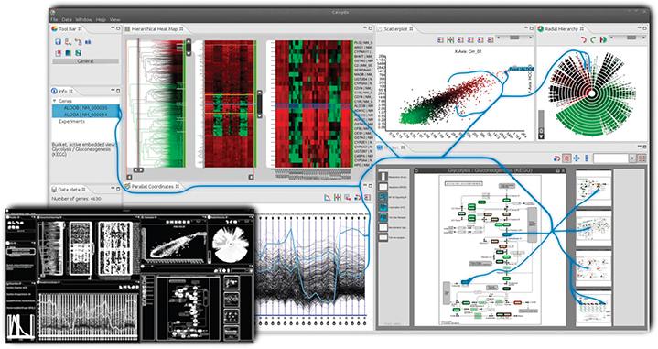
Example: context-preserving visual links
Links are drawn as curves that are carefully routed between existing elements in a vis. The route takes into account trade-offs between four criteria: minimizing link lengths, minimizing the occlusion of salient regions, maximizing the difference between the link’s colour and the colours of the existing elements that it crosses, and maximizing the bundling of links together.

Slide 13
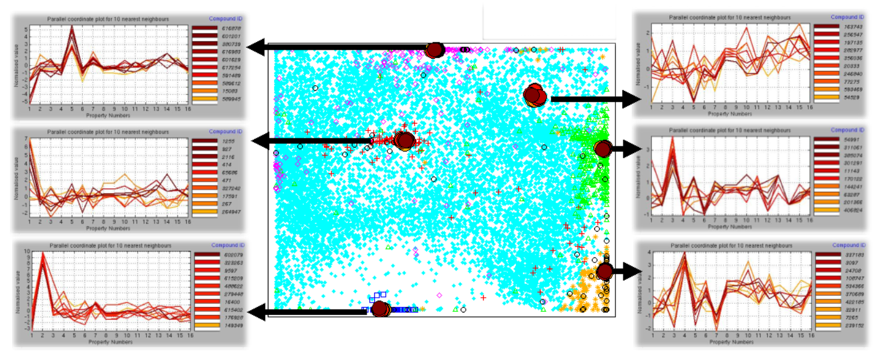
Selection outcomes
Selection is often a first step in a multistage sequence, allowing the user to indicate specific elements that should be the target of the next action.
Selected items might be filtered or aggregated, or their visual encoding could be changed.
A selected set of regions or items might be reordered within a view.
A navigation trajectory could be constructed so that a selected item is centred within the view at the end of an animated transition.

Slide 14
Navigation
Large and complex datasets often cannot be understood from only a single point of view.
Many interactive vis systems support navigation, analogous to the physical world. The spatial layout is fixed and navigation changes the viewpoint.
The term navigation refers to changing the point of view from which things are drawn. The underlying metaphor is a virtual camera located in a particular spot and aimed in a particular direction. When that camera viewpoint is changed, the set of items visible in the camera frame also changes.
Navigation can be broken down into three components.
Zooming moves the camera closer to or farther from the plane. Zooming the camera in close will show fewer items, which appear to be larger. Zooming out so that the camera is far away will show more items, and they will appear smaller.
Panning the camera moves it parallel to the plane of the image, either up and down or from side to side.
Rotating spins the camera around its own axis. Rotation is rare in two-dimensional navigation, but it is much more important with 3D motion.

Slide 15
Zooming
Geometric zooming corresponds with our real-world experience of walking closer to objects. In the 2D case, the metaphor is moving a piece of paper closer to or farther from our eyes, while keeping it parallel to our face.
With semantic zooming, the representation of the object adapts to the number of pixels available in the image-space region occupied by the object.
An abstract visual representation of a text file might always be a rectangular box, but its contents would change considerably.
When the box is small, it would contain only a short text label, with the name of the file.
A medium-sized box could contain the full document title.
A large box could accommodate a multiline summary of the file contents.
If the representation did not change, the multiple lines of text would simply be illegible when the box was small.
Another common example is that of geographic maps: e.g. https://coronavirus.data.gov.uk/details/interactive-map

Slide 16
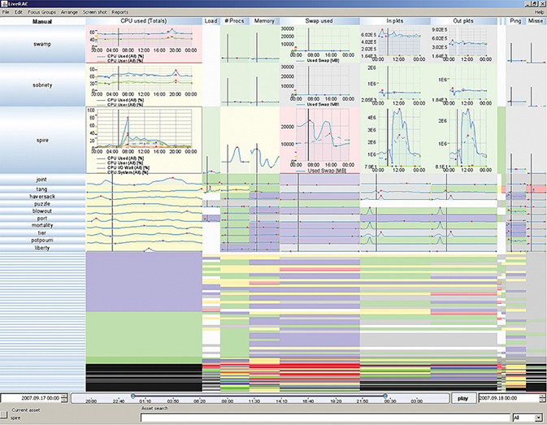
Semantic zooming: example
LiveRAC system for analyzing large collections of time-series data, in this case resource usage for large-scale system administration

Slide 17
Constrained navigation
With unconstrained navigation, the camera can move anywhere at all.
Navigating with the six degrees of freedom available in 3D space is not a skill that most people have acquired; pilots are the exception.
Constrained navigation idioms have limits on the possible motion of the camera, e.g. limiting the zoom range, so that the camera cannot zoom out much farther than the distance where the entire drawn scene is visible or zoom in much farther than the size of the smallest object.
Constrained navigation is particularly powerful when combined with linked navigation between multiple views.
For example, a tabular or list view could be sorted by many possible attributes. These views support search well, where the name of a unique item is known in advance. Clicking on that object in the list view could trigger navigation to ensure that the object of interest is framed within another view designed for browsing local neighbourhoods where the items are laid out with a very different spatial encoding.

Slide 18
Reducing attributes
The geometric intuitions that underlie the metaphor of navigation with a virtual camera also lead to a set of design choices for reducing the number of attributes: slice, cut, and project.
Although these idioms are inspired by ways to manipulate a virtual camera in a 3D scene, they also generalize to higher-dimensional spaces.
These idioms are very commonly used for spatial field datasets, but they can sometimes be usefully applied to abstract data.

Slide 19
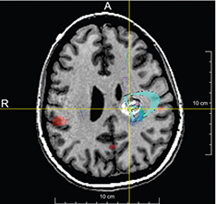
Slice
With the slice design choice, a single value is chosen from the dimension to eliminate, and only the items matching that value for the dimension are extracted to include in the lower-dimensional slice. Slicing is a particularly intuitive metaphor when reducing spatial data from 3D to 2D.
The value chosen is a height and the information extracted is the 2D position and colour for each point matching that height.
Here the slicing plane is aligned to one of the major axes of the human body, which are also the original dimensions used to gather the data.
One benefit of axis-aligned slices is that they may correspond to views that are familiar to the viewer: for example, medical students learn anatomy in terms of cross sections along the standard coronal, sagittal, and horizontal planes.

Slide 20
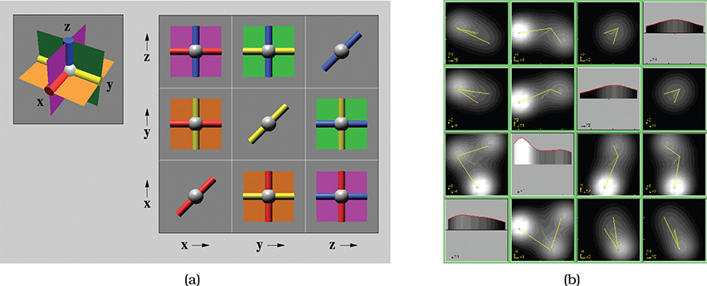
Example: HyperSlice
The visual encoding is a set of views showing all possible orthogonal two-dimensional slices aligned in a matrix.
Figure (a) shows the intuition behind the system for a simple 3D example of three planes that intersect at right angles to each other. The views are coordinated with linked navigation of the high-dimensional space, where each view is both a display and a control: dragging with a view changes the slice value based on its pair of dimensions.
Figure (b) shows a more complex four-dimensional dataset, where the function value is coded with luminance.

Slide 21
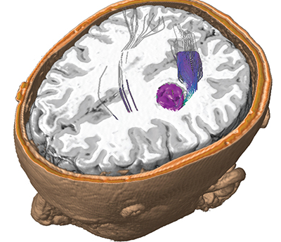
Cut
The interaction idiom of cut allows the user to position a plane that divides the viewing volume in two and everything on the side of the plane nearest to the camera viewpoint is not shown.
Cutting is often used to see features in the interior of a 3D volume. The cutting plane is set to the same level as the slice earlier.
The cut design choice shows more information than just the 2D slice alone, since the surrounding 3D context behind the cutting plane is also visible.

Slide 22
Projection
With the project design choice, all items are shown, but without the information for specific dimensions chosen to exclude. For instance, the shadow of an object on a wall or floor is a projection from 3D to 2D.
There are many types of projection; some retain partial information about the removed dimensions, while others eliminate that completely.
This term is generally used for a linear transformation to a lower-dimensional space. In the second half of the unit, we will meet with the idea of a non-linear projection.
A very simple form of projection is orthographic projection: for each item the values for excluded dimensions are simply dropped, and no information about the eliminated dimensions is retained.
Standard architectural blueprints show the three possible views for axis-aligned 2D views of a 3D XYZ scene: a floor plan for the XY dimensions, a side view for YZ, and a front view for XZ.

Slide 23
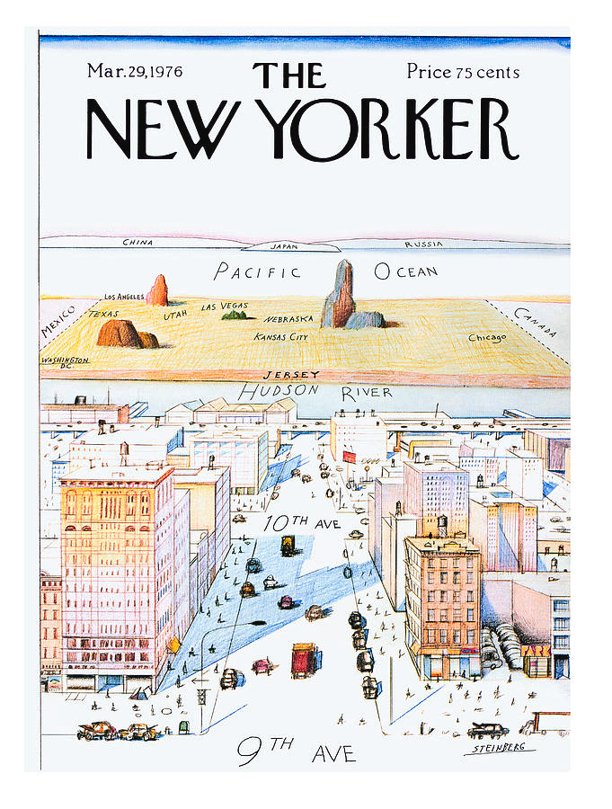
Perspective
A more complex form of projection is the standard perspective projection, which also projects from 3D to 2D. This transformation happens automatically in our eyes and is mathematically modelled in the perspective transformation used in the computer graphics virtual camera. While a great deal of information about depth is lost, some is retained through the perspective distortion foreshortening effect, where distant objects are closer together on the image plane than nearby objects would be.

Slide 24
Summary
The most fundamental breakthrough of vis on a computer display compared with printed on paper is the possibility of interactivity: responding to user input, rather than being limited to a static visual encoding.
This lecture has not discussed gesture as a means of interaction. While there is not much vis on smartphones, tablets do provide enough screen real-estate.
We will revisit much more sophisticated forms of non-linear projection in the second half of the unit

